Slide 1
Early ACCESS Service Delivery Model:
I
What does Early ACCESS Look Like?

Slide 2
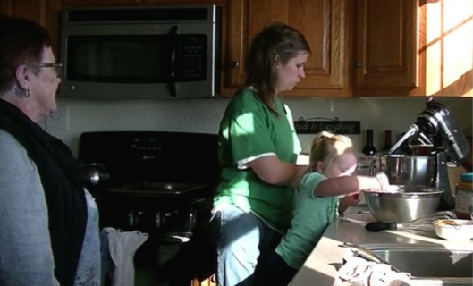
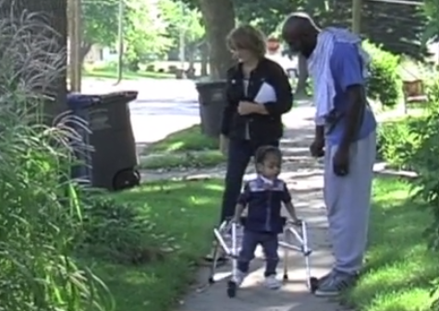
Early ACCESS SERVICES
Routines
Coaching
Daily Learning
Early intervention service provider and parents/caregivers plan and practice interventions that can be used throughout the day during activities the family is already doing.
Early intervention service provider supports family members by coaching them to help their child grow and learn.
Children learn throughout the day when they are part of activities and routines – no need to create a special “therapy” time.
For more information, see the “Early ACCESS Early Intervention in Iowa” handout
(https://www.iafamilysupportnetwork.org/files/What_Is_EA/00321_Early_ACCESS_Flyer.pdf)
Notes:
Use this handout to supplement: https://www.iafamilysupportnetwork.org/files/What_Is_EA/00321_Early_ACCESS_Flyer.pdf

Slide 3
Video Illustration
Click image to watch this video of a parent discussing the features of early intervention that have been so helpful to her family https://vimeo.com/139806903
Notes:
Watch this video of a parent discussing the features of early intervention that have been so helpful to her family: https://vimeo.com/139806903

Slide 4
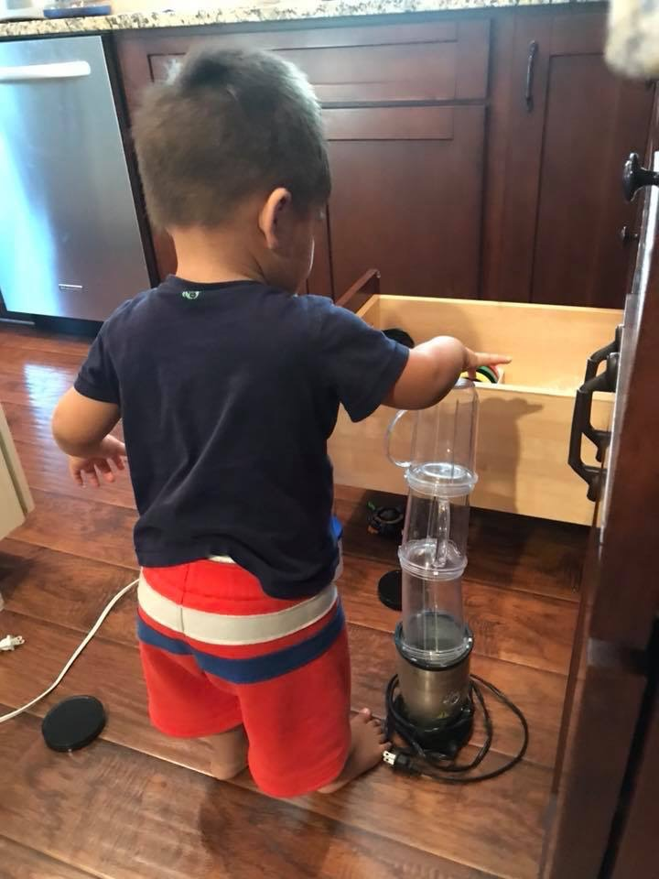
For more information
Visit the Iowa Family Support Network
(https://www.iafamilysupportnetwork.org/early-access-iowa)
Or email Dee Waddell, Early ACCESS State Coordinator
at dee.waddell@iowa.gov
Notes:
Iowa Family Support Network: https://www.iafamilysupportnetwork.org/early-access-iowa

