Slide 1
Early ACCESS
Timely Provision of
Early Intervention Services
June 2024
Notes:
You are engaging in professional learning which addresses the Timely Provision of Early Intervention Services for Early ACCESS; presented by the Iowa Department of Education’s Early ACCESS State Coordinator, Dee Waddell.

Slide 2
Learning Objectives
Participants will be able to:
Describe procedures for timely provision of early intervention services
Complete Service Logs to document provision of early intervention services
Document delays in provision of any early intervention service
Provide accurate Annual Performance Report (APR) data for Timely Provision of Services (Indicator C1)
Notes:
The target audience of this presentation is for Early ACCESS leadership, Early ACCESS service coordinators and providers.
During this presentation, participants will able to describe Early ACCESS procedures for implementing and documenting the timely provision of early interventions services; Understand the need to enter a service log to document the provision of the first early intervention service; Adequately document delays in the provision of any early intervention service; And provide complete and accurate data for Iowa’s Early ACCESS annual performance report of the timely provision of services. Referred to as APR indicator C 1.

Slide 3
Early ACCESS Procedures
Content of an IFSP
Individuals with Disabilities Education Act (IDEA) Part C and Administrative Rules for Early ACCESS establish requirements for Iowa’s Early ACCESS Services
Early Intervention Services
Documented on an Individualized Family Service Plan (IFSP)
Designed to meet the developmental needs of children and the needs of families to assist in development
Provided by qualified personnel
Provided in Natural Environments to the maximum extent appropriate
Required to provide service coordination for every family
Notes:
The Iowa IDEA Information website (referred to as i3) establishes procedures to implement the Individuals with Disabilities Education Act (IDEA) Part C and Early ACCESS Administrative Code for developing and implementing an Individualized Family Service Plan (IFSP). The Content of an IFSP includes the requirements for the IFSP Team, including the family, to select early intervention services which are designed to meet the developmental needs of the child and the needs of the family to assist in their child’s development. In Iowa, early intervention services are provided by qualified personnel defined by the appropriate licensing bureau or division. The early intervention services are provided in Natural Environments which are settings that are typical for same-aged infants or toddlers without disabilities to the maximum extent appropriate as determined by the IFSP Team. Additionally, service coordination is the only early intervention service which is required to be provided for every family in Early ACCESS.

Slide 4
Consent for Early ACCESS Services
Parent Consent
Informed Consent
Ensure parents are informed of all the information relevant to the IFSP
Understand and agree to the activities on the IFSP
Including child and family outcomes and early intervention services
Right to decline or withdraw their consent for any or all early intervention service(s)
Must obtain written consent prior to initial provision of early intervention services
Consent for Early ACCESS Services
Notes:
During the IFSP meeting, the IFSP is developed by the IFSP team. The members of the IFSP Team must discuss services which may be needed to meet the child’s unique needs and enhance the family’s capacity to meet their child’s development. The contents of the IFSP must be explained to parents so they are fully aware of and informed of all the information relevant to their child and the IFSP. Parents must understand and agree to the activities on the IFSP, which includes child and family outcomes and early intervention services. The Early ACCESS procedural safeguards for parents of children, ages birth to three, provide parents the right to consent, decline or withdraw their consent to any or all early intervention services. Thus, it is required to obtain written, signed Consent for Early ACCESS Services from the parent prior to the initial provision of any early intervention service described on the IFSP.
While parents may tell the service providers they want to start the early intervention services, it is required to obtain written, signed Consent for Early ACCESS Services prior to the initial provision of early intervention services described on the IFSP. For example, at the conclusion of an IFSP meeting the parents say they will sign the consent and return it the Service Coordinator next week. Until the consent is received and documented in ACHIEVE, an Early ACCESS provider may not provide the first service to the family and child.
Go to i3 Procedures to learn more about the requirements of Parent Consent.

Slide 5
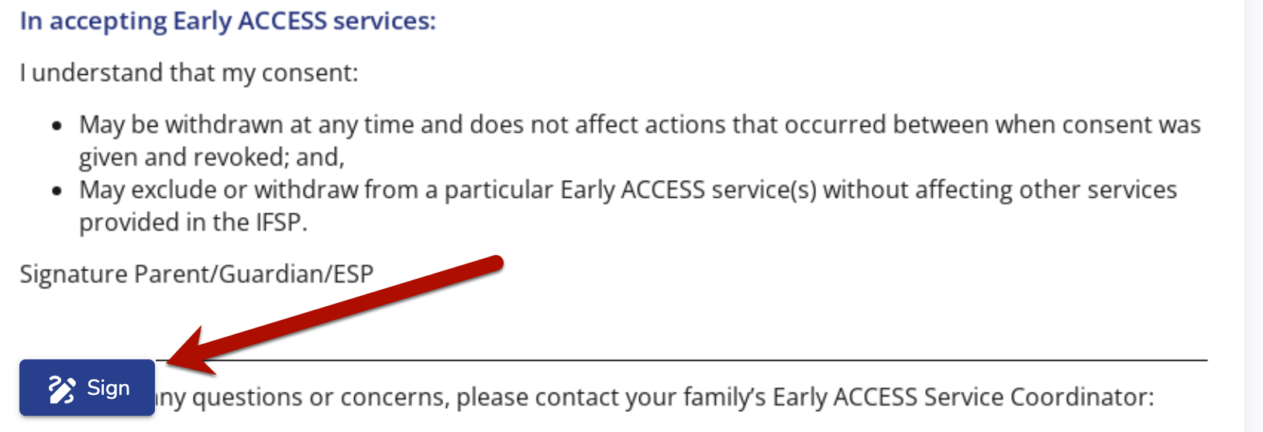
Consent for Early ACCESS Services
Informed Consent
Eligible for Early ACCESS
Early intervention services in the IFSP
Consent and Decline Services
Parent’s Signature
Consent for Early ACCESS Services
Date of Signed Consent for Early ACCESS Services
Notes:
In ACHIEVE, the Consent for Early ACCESS Services contains the components of the Informed Consent required when obtaining written parental consent. A parent acknowledges the child is eligible for Early ACCESS and the services described in the IFSP. They provide consent or decline any or all of the early intervention services listed on the IFSP and document their written consent by signing and dating the Consent for Early ACCESS Services. Any early intervention service added to subsequent IFSPs must follow the same procedure required to obtain parent’s written Consent for Early ACCESS Services.

Slide 6
Early ACCESS Procedures
Timely Provision of Early Intervention Services
Individualized Family Service Plan (IFSP) is implemented in accordance with the written IFSP
Early intervention services are available 12 months a year to meet the needs of children and families
Service(s) must be initiated as soon as possible after written parent consent has been obtained on the Consent for Early ACCESS Services
Notes:
The i3 Procedures for Early ACCESS provides information on the requirements of Timely Provision of Early Intervention Services. In relationship to the timely provision of services following parental consent, the IFSP must be implemented as written and agreed upon by the IFSP Team. Early ACCESS is provided year-round; thus, early intervention services must be initiated as soon as possible to meet the needs of the children and families.
After the IFSP Team obtains written, signed Consent for Early ACCESS Services, they begin providing early intervention services described on the IFSP.

Slide 7
Timely Provision of Early Intervention Services
Timely Provision of Early Intervention Services
Provide service(s) within 30 calendar days from Consent for Early ACCESS Services
Must have written parent consent before providing services
Applies to all early intervention services on an IFSP
Includes early intervention service(s) added to subsequent IFSPs
Calculation of Timely Provision
Start Date: Signed Consent for Early ACCESS Services
End Date: First Service Log documenting when the first services was completed
# of Days from Consent (mm/dd/yyyy) to First Service Log (mm/dd/yyyy)
Total # of days must equal 30 days or less
What does, “initiated as soon as possible” mean?
Notes:
While As Soon As Possible is not defined in the IDEA regulations, Iowa’s system of early intervention has defined the timely provision of early intervention services as initiating the service(s) within 30 calendar days from the Consent for Early ACCESS Services. The 30 calendar day timeline applies to each of the early intervention services on the Initial IFSP agreed upon by the parents consent as well as new services added to an IFSP during subsequent IFSP Meetings.
Timely provision of early intervention services is calculated from the Date of the Signed Consent for Early ACCESS Services to the Date of the First Service Log documenting when the first service was completed.
The Total # of days must be equal to or less than 30 calendar days. If the number of days is 31 or more days, then the service has not been provided in a timely manner.

Slide 8
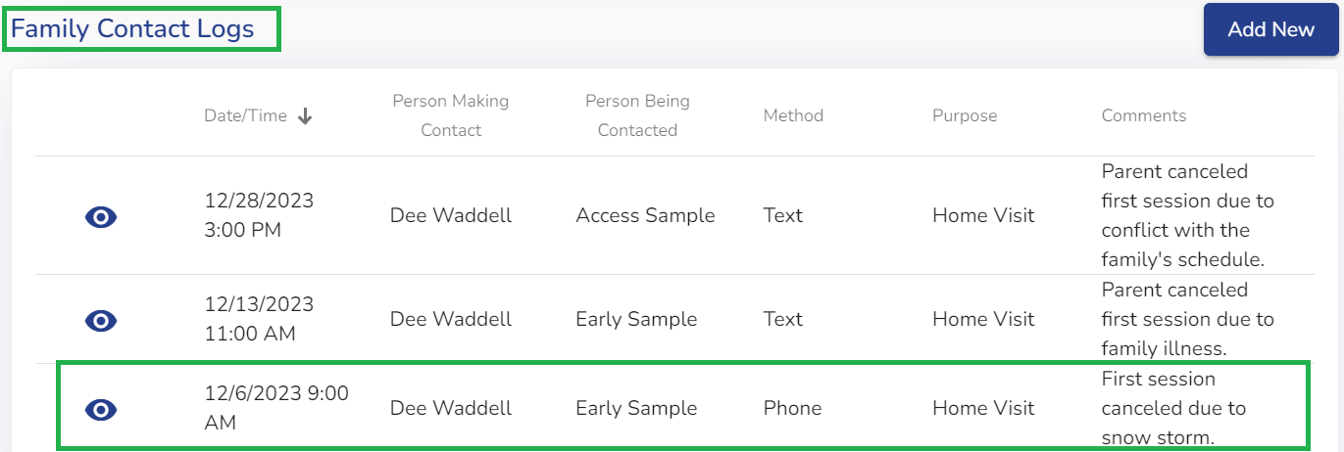
Communication with Family
Family Contact Logs
Document scheduling first service(s) in Family Contact Logs
Describe circumstances which delay providing first early intervention service
Exceptional family circumstances
First appointments canceled, missed, no response
Weather
Provide details of efforts to initiate services
Notes:
When communicating with families to schedule the first early intervention service, the team must use the Family Contact Logs section of ACHIEVE to document reasonable effort to provide the first service. The Family Contact Logs include the contacts and details of the communication in the comments field. This documentation will provide information regarding the circumstances for scheduling the first early intervention session. If a service or services are not provided within 30 days, the Family Contact Logs provide information regarding the reason for untimely provision of a service. Therefore, the Early ACCESS service provider must document attempts to schedule the first service and details such as the reason the first appointment is canceled, missed, no response to scheduled visits, weather delays, illnesses, as well as provider conflicts and reasons.
The example provided shows the Family Contact Logs with three attempts to schedule the first home visit to provide an early intervention service. From the entries, one session was canceled due to weather and two sessions were cancelled due to family circumstances. The documentation provides a record of reasonable effort to provide the first early intervention service.

Slide 9
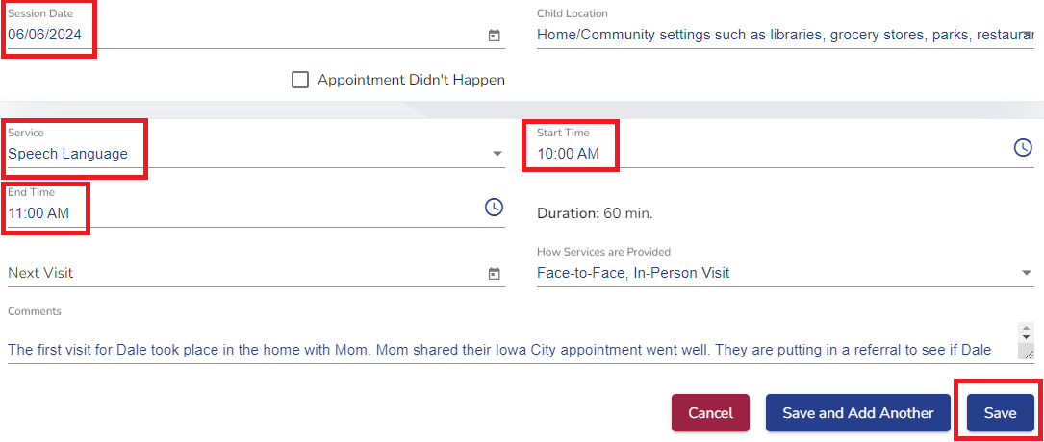
Early Intervention Service Log
Service Log Entry
Add New Log Entry to document first session for each early intervention service
Session Date: Check and Edit to correct Date of Session
Service
Start and End Time
Notes:
When an early intervention service is provided, the details of the session are recorded using the service log in the ACHIEVE system. The first section of the Service Log consists of documentation of the service provided during a visit to meet the child and family’s needs. The information recorded in the Service Log is used as part of the data collection to calculate the timely provision of the first session for each early intervention service. Therefore, each service provider is required to Add a New Log Entry to document the provision of an early intervention service.
The service provider must generate a Service Log by clicking the Add New Log Entry in ACHIEVE. This will open a Service Log, where the Service Provider will complete at least the following fields:
Ensure the Session Date is the date of the session. Please note when a new log entry is opened, the Session Date automatically populates with the current date so you may need to edit the date to the date of the session.
Add the service being provided.
Record the start time and end time.
After clicking save, ensure all the information is entered correctly in the service log. When a session involves the first delivery of one or more services, it is not adequate for ONE service provider to enter one Log Entry for ALL service providers. This does not provide the documentation necessary to demonstrate the first delivery for each of the early intervention services.

Slide 10
IFSP Meeting & Early Intervention Services
First Service Provided on Date of IFSP Meeting
Ensure service(s) initiated on date of IFSP Meeting provides documentation:
IFSP is finalized
Parent signed Consent for Early ACCESS Services
Session Start Time is after IFSP Meeting concluded
Notes:
When the early intervention service(s) are provided on the same date as the IFSP Meeting, the IFSP Team must ensure the IFSP is finalized; parents are fully informed of the services on the IFSP and have signed the Consent for Early ACCESS Services. Furthermore, the Session Log must clearly illustrate the service is provided after the IFSP Meeting has concluded. In this example of a service log, the documentation shows the Start Time is after the time of the Scheduled IFSP Meeting and a comment indicates the service(s) are provided after the IFSP was completed and a parent signed the Consent.

Slide 11
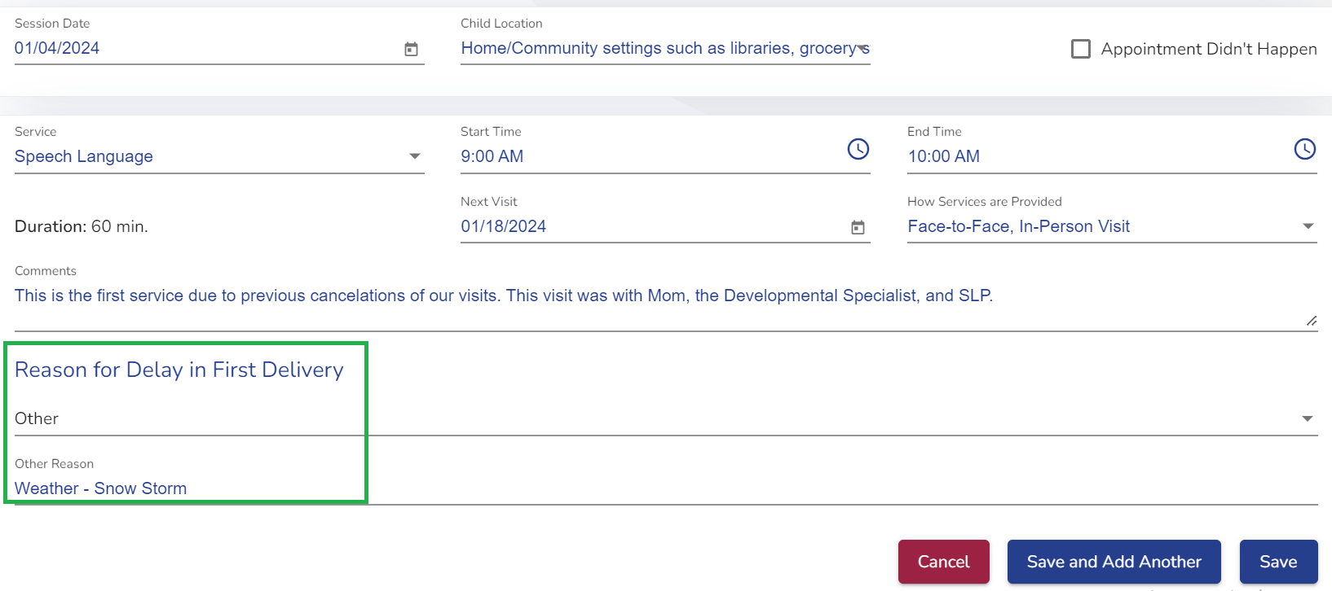
Early Intervention Service Log
Delay in Provision of Early Intervention Service
Service provided more than 30 calendar days after Consent for Early ACCESS Services
Reason for Delay in First Delivery must be documented on Service Log Entry
Family
Agency
Public Health Emergency
Other
Note: Family Contact Logs
Documentation of contact(s)
Circumstance(s) causing delay
Resource: Codes & Definitions Used in the ACHIEVE System - Early Intervention - Defines reasons for delay in first delivery of a service.
Notes:
When an early intervention service is provided more than 30 calendar days after the Consent of Early ACCESS Services, the ACHIEVE system will automatically require the service provider to indicate the Reason for Delay in First Delivery. As has been described, the ACHIEVE system calculates the 30 calendar days based on the number of days from the date of the signed Consent for Early ACCESS Services to the Session Date entered on the Service Log Entry.
Reasons for delay in the 1st delivery must be documented on the service log entry, which are:
Family reason
Agency reason,
Public health emergency that is issued as a governor's emergency proclamation; or
Other.
Use “Other” only if the circumstance for the delay is not defined in the other reasons such as weather.
Additionally, the documentation in the family contact logs section of ACHIEVE, which was described previously, will provide the details of the efforts to schedule the first session and circumstances causing the delay.
Please refer to the resource, Codes & Definitions Used in the ACHIEVE System - Early Intervention, in the i3 Ealry Intervetion Resources which defines the delay reasons.

Slide 12
Early Intervention Service Log
Additional Service Log sections in ACHIEVE include:
Comments
Recent events, health updates, appointments
Monitoring for Progress
How is the plan working?
Celebrations and Reflections
Degree of progress toward achieving outcomes identified in the IFSP
Family Guided Routines Based Intervention (FGRBI) Plan (Family 5Q)
Discussions, routines, and a plan for practice between visits
What specific targets, steps or parts of the skill, they want their child to learn.
Why the targets are important skills or behaviors that will support their child’s development.
Where, When, and with Whom the embedded learning opportunities will take place.
How, or the strategies the caregiver will use, that support learning for their child
How will the caregiver know if the plan is working to meet the outcomes they have identified.
Notes:
Additional sections on the Service Log page in ACHIEVE are used to document the coaching components to support family or caregiver - child interactions and learning include:
Comments: This section of the Service Log may be used to record information the family shares such as family events, upcoming appointments, and updates
Monitoring for Progress: The Monitoring for Progress section in ACHIEVE is structured to record qualitative and quantitative data on the progress towards achieving child and family outcomes and priorities. This section of the Service Log is used to record the family’s reflections on “How is the plan working?”. This information may be gathered throughout the visit with families as they share concerns, challenges, and celebrations. Additionally, the providers document information and data on the progress towards achieving the Child and Family Outcomes identified in the IFSP.
FGRBI Plan: The FGRBI plan represents the Family 5Q or the 5 Questions used with the family or caregiver to identify learning priorities and embedded learning opportunities to practice during meaningful routines and activities throughout the day. The providers and families use the Family 5Q to determine what the family or caregiver wants to work on; who will do what during routines; how to organize the environment; how, when, and where strategies will be used; and how will the the family or caregiver know the plan is working.

Slide 13
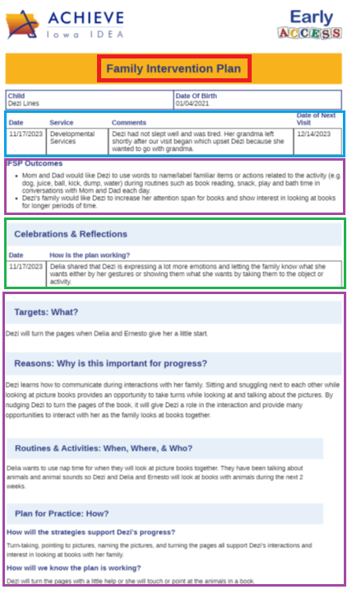
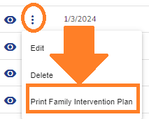
Family Intervention Plan
Service Log Transforms to Family Intervention Plan!
Session Details
Date
Service
Comments
Date of Next Visit
Monitoring for Progress (Celebrations and Reflections)
How is the Plan Working?
Family Guided Routines Based Intervention Plan (FGRBI)
IFSP Outcomes
What
Why
When, Where, Who
How
How we know it is working
Notes:
The Early ACCESS service providers can generate a Family Intervention Plan as a summary of the conversations, interventions, and outcomes from the visit with the family and child. To bring it all together, the Service Log Entry transforms into the Family Intervention Plan! The Family Intervention Plan includes many of the components of the Service Log. Additionally, once information is entered into the FGRBI section of the Service Log, which will auto populate into the Family Intervention Plan; the IFSP Team will be able to share the Plan with the families through the ACHIEVE Family Portal. However, the FGRBI section must have at least one of the 5 questions completed to generate and print the Family Intervention Plan in ACHIEVE. After the Family Intervention Plan is opened using the print button, it becomes available on the ACHIEVE Documentation page under the Documents heading.
For more information on generating the Family Intervention Plan, please refer to the ACHIEVE Early ACCESS User Guide.

Slide 14
Annual Performance Report
Iowa’s System of General Supervision for Early ACCESS
Annual Performance Report (APR) Compliance Indicator (C1)
Percent of infants and toddlers with an Individualized Family Service Plan (IFSP) receiving early intervention services on their IFSP in a timely manner.
Ensure timely initiation of all new early intervention services identified on the IFSP
APR Documentation
Account for timely provision of early intervention services
Service(s) provided within 30 calendar days from the date in which Consent for Early ACCESS Services is obtained
# of Days from Consent for Early ACCESS Services (mm/dd/yyyy) to first Service Log Entry (mm/dd/yyyy) is equal to or less than 30 calendar days
Account for untimely receipt of early intervention services
First Service Log Entry - Reason for Delay in First Service
Exceptional family circumstances documented in child’s records - Family Contact Logs
Notes:
As a component of Iowa’s System of General Supervision, Early ACCESS annually analyzes and reports the results of the Timely Provision of Early Intervention Services in the Annual Performance Report (or APR) for Indicator C1. This is a compliance indicator which means 100% of infants and toddlers must receive early intervention services within 30 calendar days. Again, the data used to report compliance for this Indicator is calculated from the date the Consent for Early ACCESS services is obtained to the date the first Service Log Entry is entered in ACHIEVE.
Thus, if there is not a Service Log entered within 30 calendar days from the Consent for Early ACCESS Services, the provision of the service is reported as untimely and not in compliance with requirements. Every service provide must account for untimely provision of early intervention services.
The reported Reason for Delay in First Service is also reviewed and considered as part of the reason for delay. While the agency must address circumstances in which services are untimely, Family reasons for a delay are reported as exceptional circumstances. The child’s Family Contact Logs must include the details which support the reason for the delay.

Slide 15
Resources
Early Intervention Procedures (i3)
Contents of an IFSP
Parent Consent
Early Intervention Services
Timely Provision of Early Intervention Services
Codes & Definitions Used in the ACHIEVE System - Early Intervention
Early Intervention Service Log
Early Intervention Practices
Family Guided Routines Based Intervention (FGRBI)
Setting the Stage for FGRBI
Family Role in Early ACCESS Visits
Notes:
Other resources for completing the IFSP and provision of early intervention services are provided in the i3 early intervention procedures as well as early intervention practices linked on this slide.

Slide 16
Timely Provision of Early Intervention Services Self-Assessment
Mark the following statements as True or False about early intervention services.
Statement
Early intervention services are designed to meet the developmental needs of children and needs of their families to assist in development.
Families have the right to consent and decline which of the services being proposed they receive.
Early intervention services begin after families are informed and understand all the information on the IFSP.
Early intervention services on the IFSP must begin as soon as possible after Consent for Early ACCESS is obtained.
Since it is the beginning of summer, the first service will be provided when school starts in August.
Notes:
Take some time to reflect on the information presented. Do a quick knowledge check by completing the Self-Assessment about Early Intervention Services!

Slide 17
Timely Provision of Early Intervention Services Self-Assessment
Choose the correct statement about timely provision of early intervention services.
Timely Provision of Early Intervention Services:
Applies to only the early intervention service(s) on Initial IFSPs
Enter a Service Log in ACHIEVE to document providing a first service within 30 calendar days from the date obtained the Consent for Early ACCESS Services
Calculation is from the date of IFSP Meeting to the first scheduled visit
All of the above
Notes:
Do a quick knowledge check by completing the Self-Assessment about Timely Provision of Early Intervention Services!

Slide 18
Timely Provision of Early Intervention Services Self-Assessment
Pause for a Knowledge Check!
Play to Continue!

Slide 19
Timely Provision of Early Intervention Services Self-Assessment
Answer Key about early intervention services.
Statement | True or False
Early intervention services are designed to meet the developmental needs of children and needs of their families to assist in development. | True
Families have the right to consent and decline which of the services being proposed they receive. | True
Early intervention services begin after families are informed and understand all the information on the IFSP. | False (Must obtain Consent for EA Services)
Early intervention services on the IFSP must begin as soon as possible after Consent for Early ACCESS is obtained. | True
Since it is the beginning of summer, the first service will be provided when school starts in August. | False (Year Round Services)
Notes:
Check your learning about Early Intervention Services!

Slide 20
Timely Provision of Early Intervention Services Self-Assessment
Answer Key about timely provision of early intervention services.
Applies to only the early intervention service(s) on Initial IFSPs
Document providing first service(s) within 30 calendar days (via Service Log in ACHIEVE) from date obtained the Consent for Early ACCESS Services
Calculation is from the date of IFSP Meeting to the first scheduled visit
All of the above
Notes:
Check your learning about Timely Provision of Early Intervention Services!

Slide 21
Timely Provision of Early Intervention Services Self-Assessment
Exit Ticket!
3
2
1
Write…
3 Things Learned or Recalled Learning
2 Interesting Ideas to Share with Others
1 Thing that Surprised You
Notes:
As you prepare to conclude this professional learning, please record
3, Things Learned or Recalled Learning
2, Interesting Ideas to Share with Others
1, Thing that Surprised You!

Slide 22
Notes:
Thank you for your participation in the professional learning about Early ACCESS and timely provision of early intervention services.

